Slide 1
Machine Learning
Machine Learning Introduction to Machine Learning by Kumar Anurupam is licensed under a Creative Commons Attribution-4.0 International License.
Artificial Neural Networks – CNN - I
CS 3104 Fall 2019
Lecture Slides by Kumar Anurupam

Slide 2
Learning Objectives
After completion of today’s session you will be able to:
Explain the basics of CNN.
Elaborate the motivation behind using CNN.
Illustrate the process of Edge detection in images.

Slide 3
Convolutional Neural Network (CNN)
In deep learning, a convolutional neural network (CNN, or ConvNet) is a class of deep neural networks, most commonly applied to analyzing visual imagery.
Became popular after 2012 (Imagenet).
It is an application of deep learning in the area of Computer/Machine Vision (ML/AI + Image/Video processing).
The architecture of a ConvNet is analogous to that of the connectivity pattern of Neurons in the Human Brain and was inspired by the organization of the Visual Cortex.

Slide 4
CNN Applications
The well known application areas of CNN are:
Image and video recognition
Recommender systems
Image classification
Medical image analysis
Natural language processing etc…

Slide 5
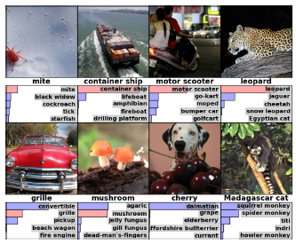
Imagenet classification through CNN

Slide 6
Motivation
In 1981, David Hunter Hubel and Torsten Wiesel won Nobel Prize in Physiology or Medicine for their discoveries concerning information processing in the visual system.
They did extraordinary work regarding the structure and function of the visual cortex.
In one experiment, done in 1959, they inserted a microelectrode into the primary visual cortex of an anesthetized cat.
They then projected patterns of light and dark on a screen in front of the cat. They found that some neurons fired rapidly when presented with lines at one angle, while others responded best to another angle.
Some of these neurons responded to light patterns and dark patterns differently.

Slide 7
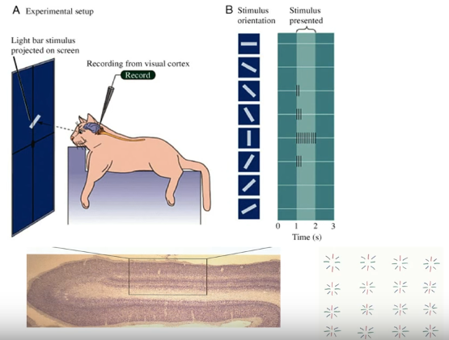
Hubel’s experiment

Slide 8
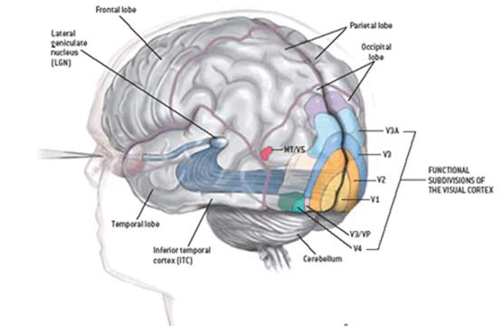
Subdivision of visual cortex

Slide 9
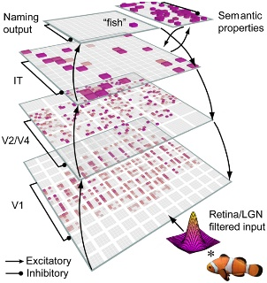
Visual Cortex layers working

Slide 10
Convolution : Edge detection in images
0 | 0 | 0 | 0 | 0 | 0
0 | 0 | 0 | 0 | 0 | 0
0 | 0 | 0 | 0 | 0 | 0
255 | 255 | 255 | 255 | 255 | 255
255 | 255 | 255 | 255 | 255 | 255
255 | 255 | 255 | 255 | 255 | 255
Grayscale image: 0 to 255
After normalization:
0 to 1
6 X 6
6 X 6
1 pixel
Input Image
Image matrix

Slide 11
Horizontal edge detection
Output Image
0 | 0 | 0
-1020 | -1020 | -1020
-1020 | -1020 | -1020
0 | 0 | 0
0 | 0 | 0 | 0 | 0 | 0
0 | 0 | 0 | 0 | 0 | 0
0 | 0 | 0 | 0 | 0 | 0
255 | 255 | 255 | 255 | 255 | 255
255 | 255 | 255 | 255 | 255 | 255
255 | 255 | 255 | 255 | 255 | 255
Convolution
Sobel horizontal edge detector
+1 | +2 | +1
0 | 0 | 0
-1 | -2 | -1
*
4 X 4
3 X 3
Normalization
(min and max)
255 | 255 | 255
0 | 0 | 0
0 | 0 | 0
255 | 255 | 255
(kernel/filter/mask/operator)
6 X 6
Image Matrix
4 X 4
Output Image after normalization

Slide 12
Horizontal edge detection
255 | 255 | 255
0 | 0 | 0
0 | 0 | 0
255 | 255 | 255
2 pixels
4 X 4
Output Image after normalization

Slide 13
Vertical edge detection
For the vertical edge detection use the Sobel vertical edge detector. All the other steps are same.
Note: There are many types edge detectors. We can use any one according to our requirement.
+1 | 0 | -1
+2 | 0 | -2
+1 | 0 | -1
3 X 3

Slide 14
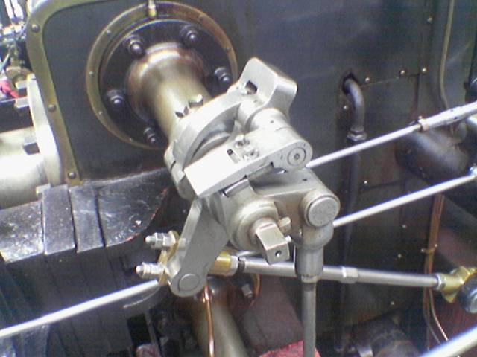
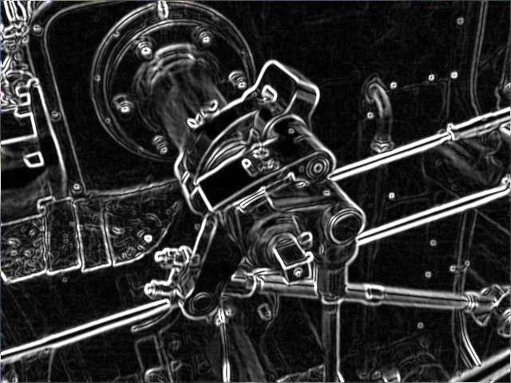
After applying horizontal and vertical edge detection

Slide 15
References
[1] https://en.wikipedia.org/wiki/Convolutional_neural_network
[2] Krizhevsky, Alex; Sutskever, Ilya; Hinton, Geoffrey E. (June 2017). "ImageNet classification with deep convolutional neural networks" (PDF). Communications of the ACM. 60 (6): 84–90. doi:10.1145/3065386. ISSN 0001-0782.
[3] https://www.frontiersin.org/files/Articles/34845/fpsyg-04-00124-HTML/image_m/fpsyg-04-00124-g001.jpg
[4] https://en.wikipedia.org/wiki/Sobel_operator
[5] Slides inspired by the Applied AI Course

Slide 16
Thanks

